Slide 1
Nfinity Games
Customer Support Improvements

Slide 2
Index
Current State of Point Blank Turkey Service
Ticket Application Form Sample
Publishers
Joygame
Nexon EU
MaynGames
GameForge
gPotato
Gamerage

Slide 3
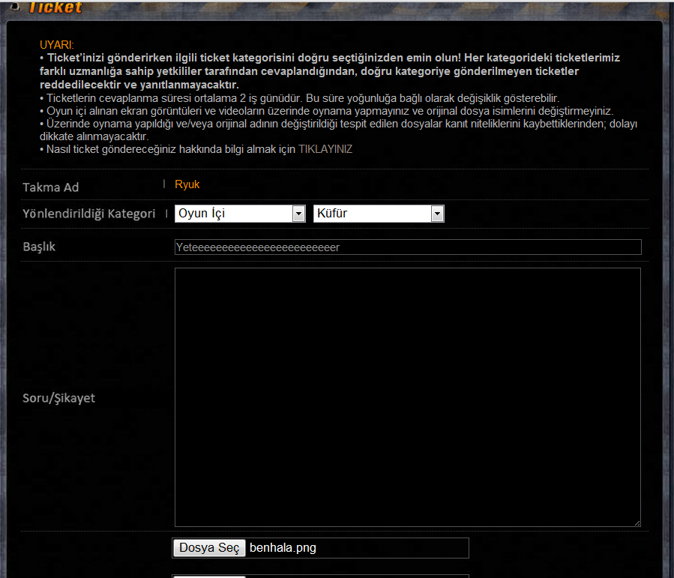
Current CS of Point Blank Service
Category
Issue Type
Subject
Details
1
2
3
4

Slide 4
CS Research
Publishers

Slide 5
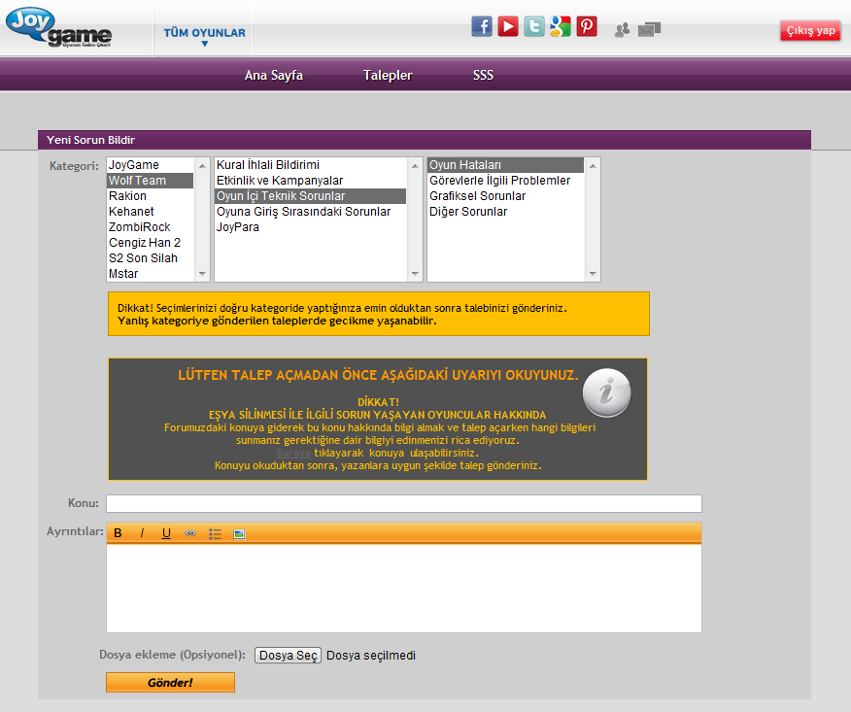
1. JoyGame
Games
Category
Issue Type
Subject
Details
1
2
3
4
5

Slide 6
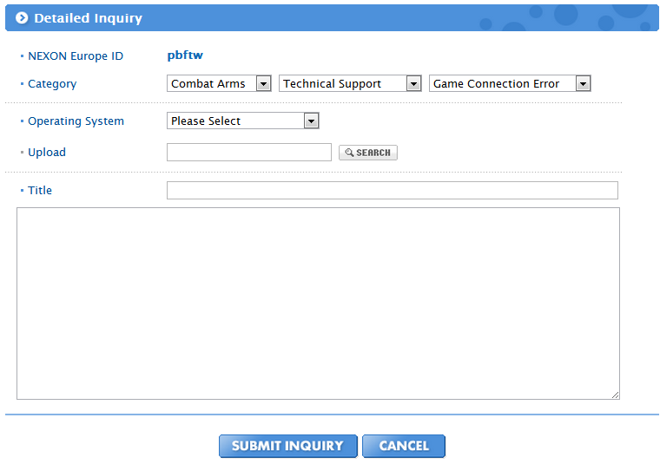
2. Nexon EU

Slide 7
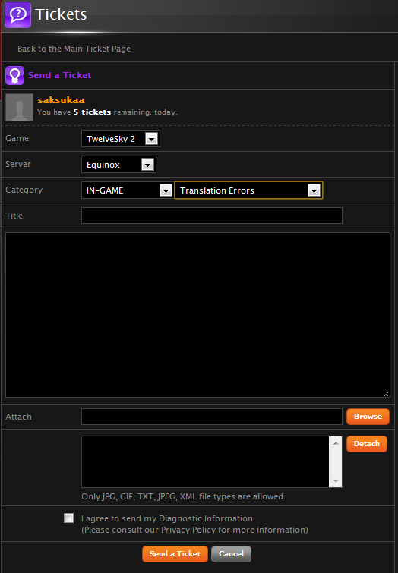
3. MaynGames

Slide 8
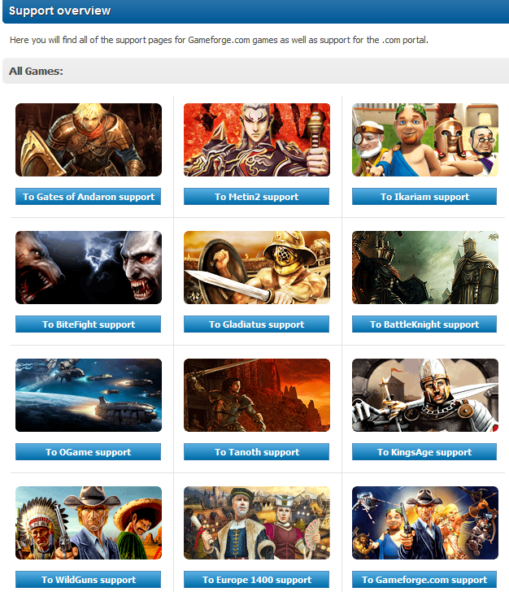
4. Gameforge
Users should select the game on CS menu first.
After Game has been selected, page is directing to users to CS page of related games web page.

Slide 9
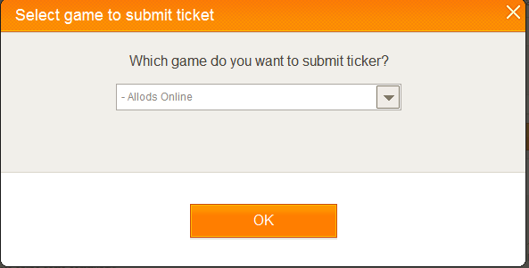
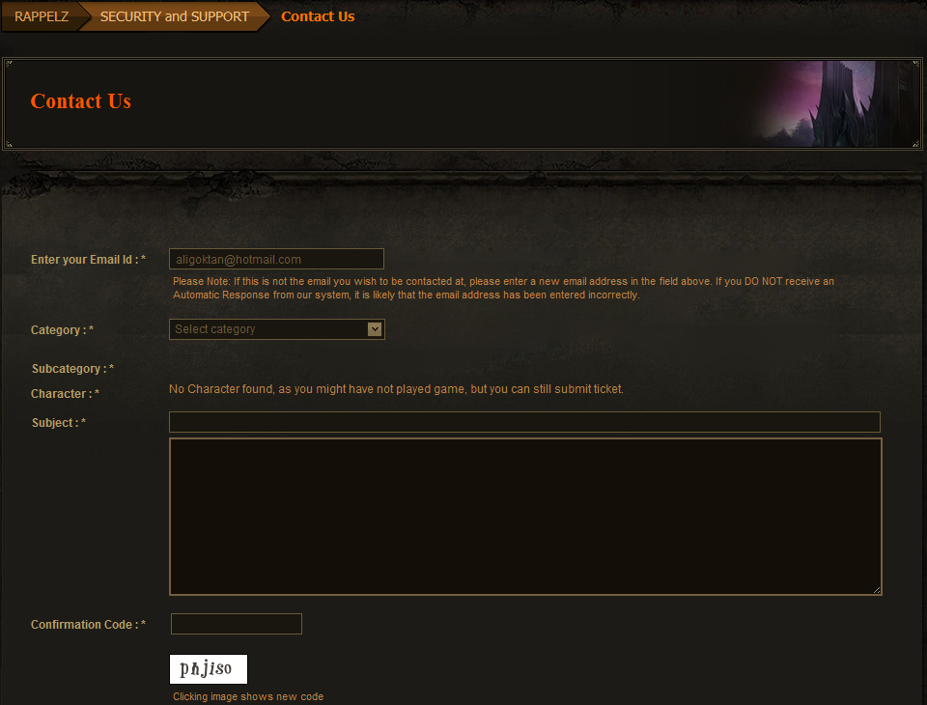
5. gPotato
1
2
Users should select the game on CS menu first.
After Game has been selected, page is directing to users to CS page of related games web page.

Slide 10
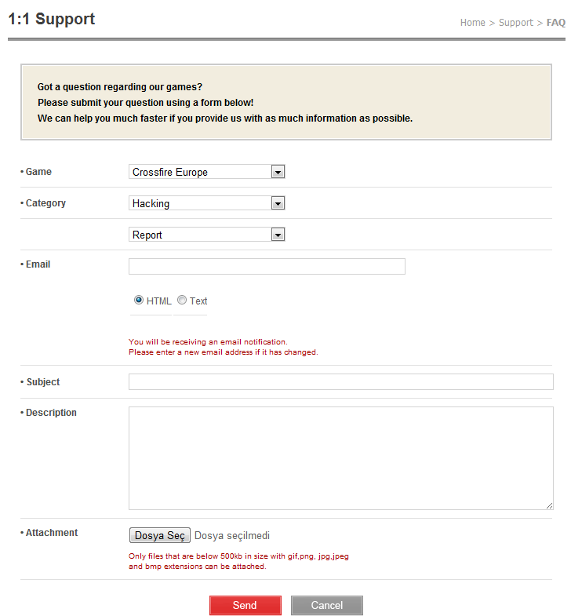
6. Game Rage

Slide 11
CS Research
Results

Slide 12
Results
As you could see on previous CS system samples, almost all of publishers use a CS system for all games.
Auto-Reply system can be used on CS system such as Report Hack tool issues etc.
We can divide the tickets by admin tool from ticket pool.
GM Ticket account system can be created for each GM. With that, employee performance can be followed also.

